Slide 1

Orbit
Earth’s orbit
Sun
Earth

Slide 2
Orbit Assumptions
Earth’s orbit
Sun
Earth

Slide 3
Orbit Assumptions
Earth’s orbit
Sun
Direction of travel
Earth

Slide 4
Orbit Assumptions
Earth’s orbit
Direction of travel
Earth
Sun

Slide 5





Orbit Make in Scratch
Earth’s orbit
Sun
Earth

Slide 6
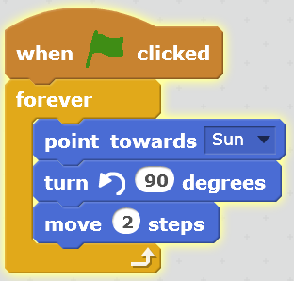
Orbit Make in Scratch
START
Turn 90º to Sun
Move

Slide 7
Orbit Questions
In what ways is this a good model of an orbit?
In what ways is it not? … so how could it be improved?
Describe any problems that are caused by us using Scratch to make the model.

